Slide 1

MAJOR PROJECT
Department of AIML
Healthcare Predictive Analytics for Diseases Diagnosis
Project Guide :-
Prof. Dr. Hasib Shaikh
Group Members:-
Ms. Arhama Ansari -- 03
Mr. Shreyash Narvekar -- 71
Mr. Brijesh pal – 73
Mr. Shivam Kumar Yadav – 134

Slide 2
CONTENTS
Abstract
Problem statement and objectives
Literature survey
Proposed system
System Architecture
Project Modules
Partial implementation
Conclusion

Slide 3
Abstract
Healthcare predictive analytics has become an indispensable tool in modern medicine, offering a proactive approach to disease detection and management.
This abstract provides an overview of the Web application of predictive analytics in disease prediction, diagnosis, and treatment.
This abstract provides an overview of the role of predictive analytics in healthcare, focusing on its application in disease prediction, diagnosis, and personalized treatment strategies.
Healthcare predictive analytics has emerged as a promising approach for improving disease diagnosis and patient outcomes.
Healthcare predictive analytics for disease diagnosis has emerged as a transformative approach in modern medicine, facilitating early detection, accurate prognosis, and personalized treatment strategies

Slide 4
Problem statement and Objectives
Despite advancements in healthcare technology, timely and accurate disease diagnosis remains a challenge.
Design and implement machine learning algorithms that can accurately predict the likelihood of various diseases based on diverse patient data inputs, including electronic health records, medical imaging, genetic information, and lifestyle factors.
The objective is to enhance the accuracy and precision of disease diagnosis through the integration of predictive analytics tools into clinical workflows.
Healthcare providers often face difficulties in identifying high-risk individuals or predicting disease progression using traditional diagnostic methods.
Many diseases are diagnosed at advanced stages, leading to poorer outcomes and increased healthcare costs.

Slide 5
Literature survey
The objective of this literature survey is to explore existing research and literature related to healthcare predictive analytics for disease diagnosis.
By addressing these objectives, predictive analytics has the potential to revolutionize disease diagnosis and improve patient outcomes in healthcare.
Several studies have proposed frameworks and guidelines for ethical implementation of predictive analytics in healthcare.
Research in personalized medicine has increasingly utilized predictive analytics to tailor treatment strategies to individual patient characteristics.
Techniques such as machine learning, deep learning, and ensemble methods are commonly employed to analyze large-scale healthcare datasets and identify patterns indicative of disease onset or progression

Slide 6
Sr no | Paper Title (Reference) | Year | Conclusion | Author name | Abstract
1 | Improving Healthcare Prediction of Diabetic Patients Using KNN Imputed Features and Tri-Ensemble Model Case study ( Advances in Science and Engineering Technology International Conferences (ASET). IEEE, 2024.) | 2024 | This approach is expected to yield further enhancements in the model’s performance,particularly when dealing with datasets of larger dimensions, ultimately leading to more resilient and versatile results. | Prof.(Dr.) KHALED ALNOWAISER | The aim of this study is to propose an automated method for predicting diabetes, with a focus on appropriately dealing with missing data and improving accuracy. The proposed framework makes use of K-Nearest Neighbour (KNN) imputed features along with a Tri-ensemble voting classifier model
2 | Healthcare predictive analytics using machine learning and deep learning techniques. Case study (Department of Computer Sciences, Faculty of Graduate Studies for Statistical Research . IEEE, 2023) | 2023 | This work advances research in the field of healthcare predictive analytics using ML and DL approaches and contributes to the literature and future studies by serving as a resource for other academics and researchers. | Mr. Mohammed Badawy Mr.Nagy Ramadan Mr. Hesham Ahmed Hefny | Healthcare prediction has been a significant factor in saving lives in recent years. In the domain of health care, there is a rapid development of intelligent systems for analyzing complicated data relationships and transforming them into real informa tion for use in the prediction process.
3 | Significance of machine learning in healthcare: Features, pillars and applications | 2022 | To improve overall health, health organisations recognise that they must address the whole person, including lifestyle and environment. ML models can identify patients at a higher risk of developing preventable chronic diseases like heart disease, diabetes, etc. | Mohd Javaid Abid Haleem Ravi Pratap Singh Shanay Rab | The applications of this technology in healthcare operations can be tremendously advantageous to the organisation. ML-based tools are used to provide various treatment alternatives and individualised treatments and improve the overall efficiency of hospitals and healthcare systems while lowering the cost of care. Shortly, ML will impact both physicians and hospitals.

Slide 7
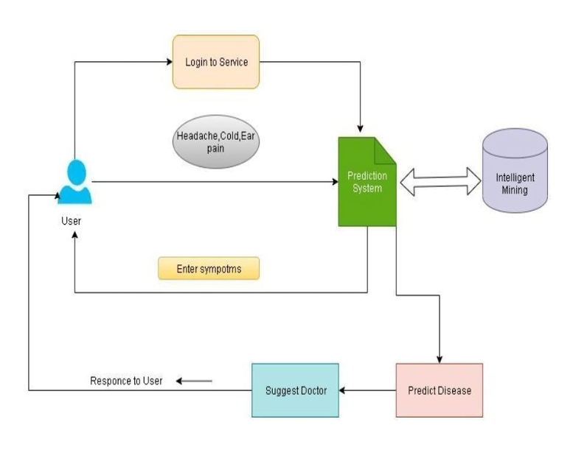
Proposed System

Slide 8
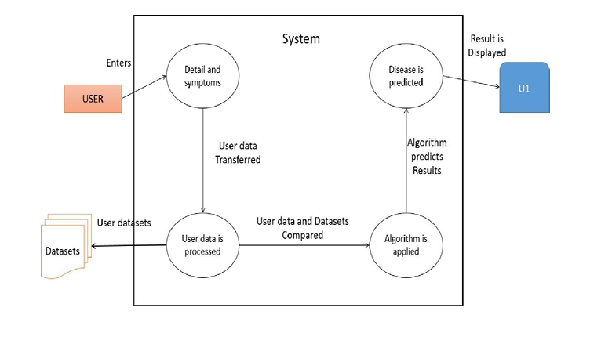
Flowchart of the proposed method

Slide 9
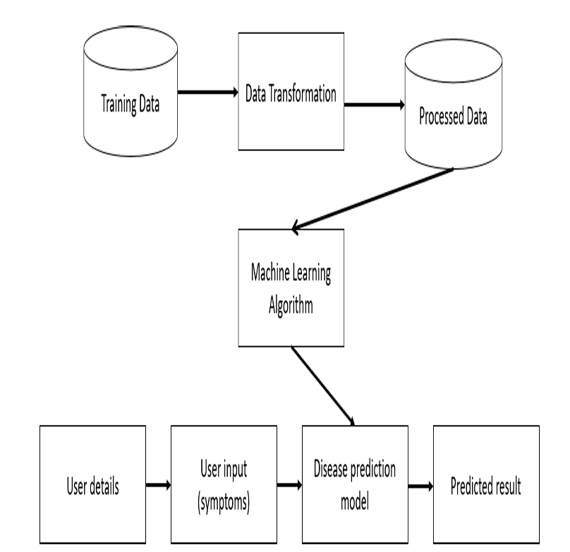
System Architecture

Slide 10
Project Modules
1.Hardware Requirements:
Processor: intel core i3,i5
RAM:4GB
Hard Disk: Minimum 500 GB
2.Software Requirements:
Operating system: windows 7/8/10/11
Programming language: python 3.8.3
Python Libraries: Numpy,Pandas,Matplotlib,etc
Machine Learning-Related Tools: scikit-learn,scipy,streamlit,etc.
Web framework: flask
Deep learning algorithm: convolutional neural network (CNN)
Browser: Google Chrome | API

Slide 11
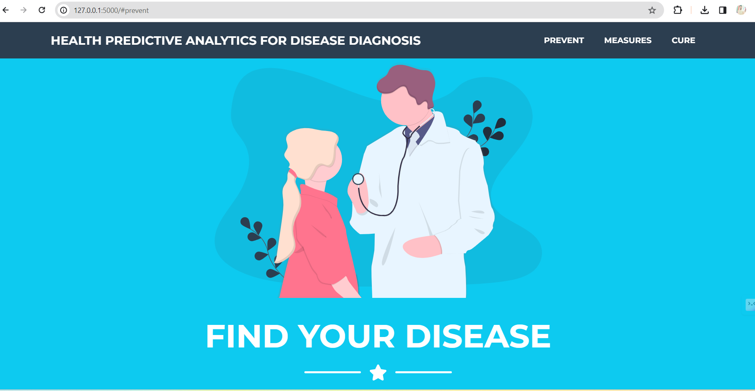
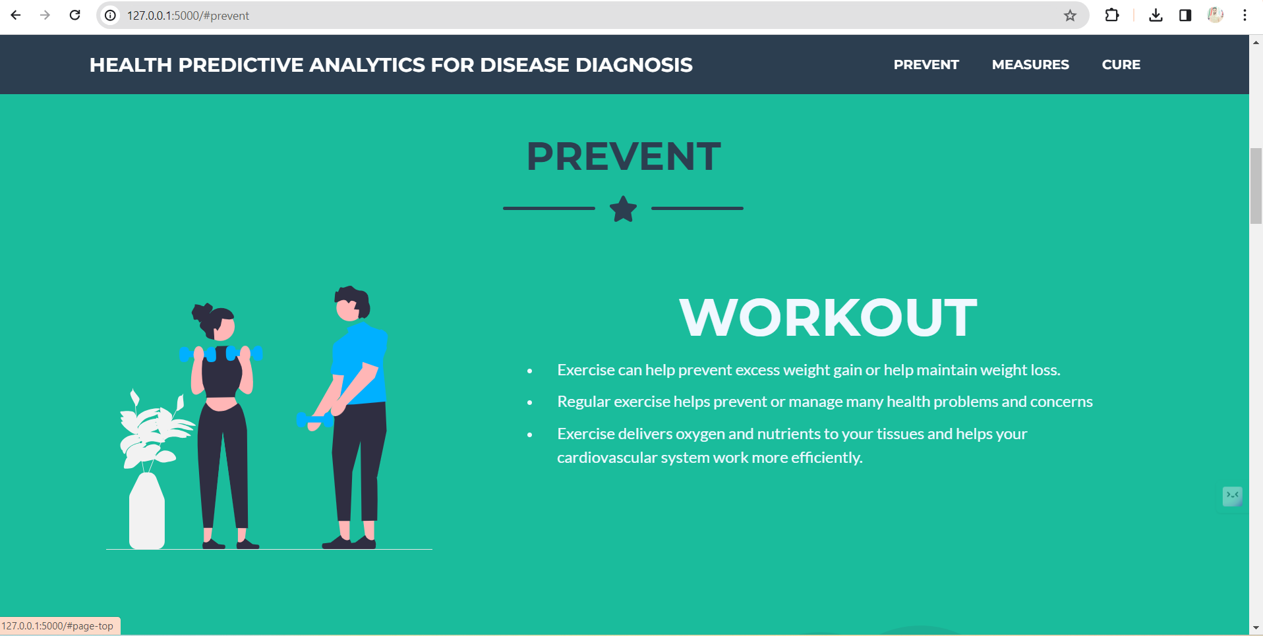
Partial Implementation

Slide 12
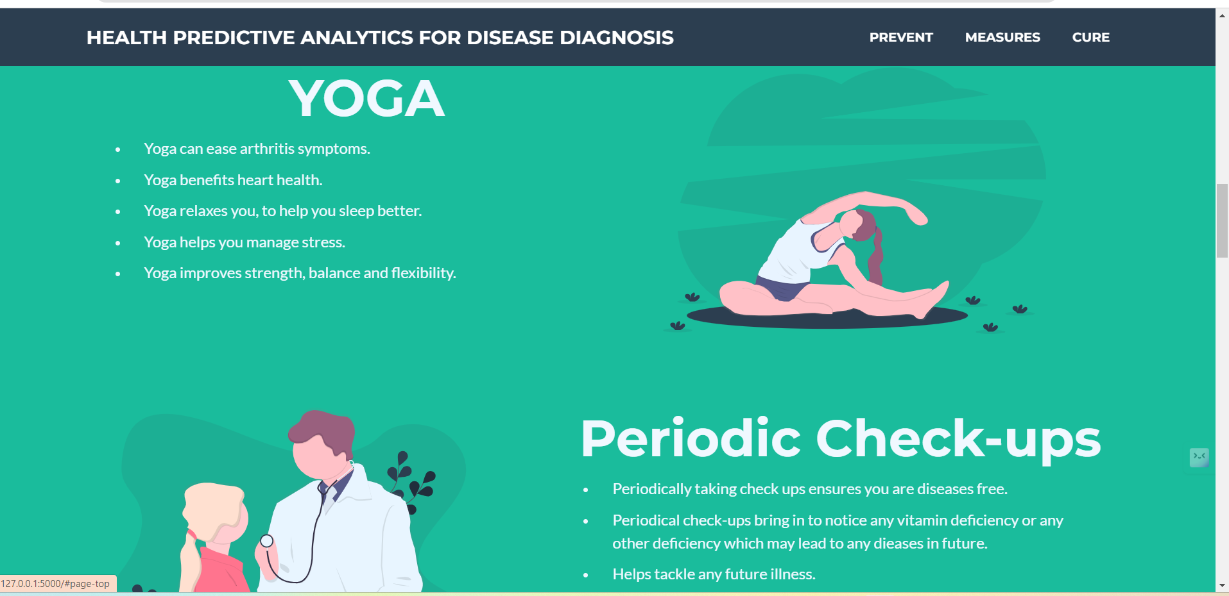
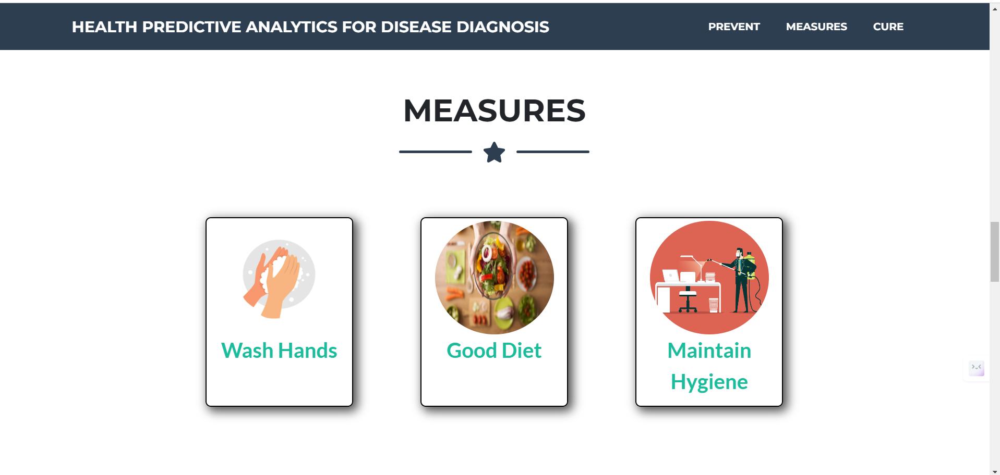

Slide 13
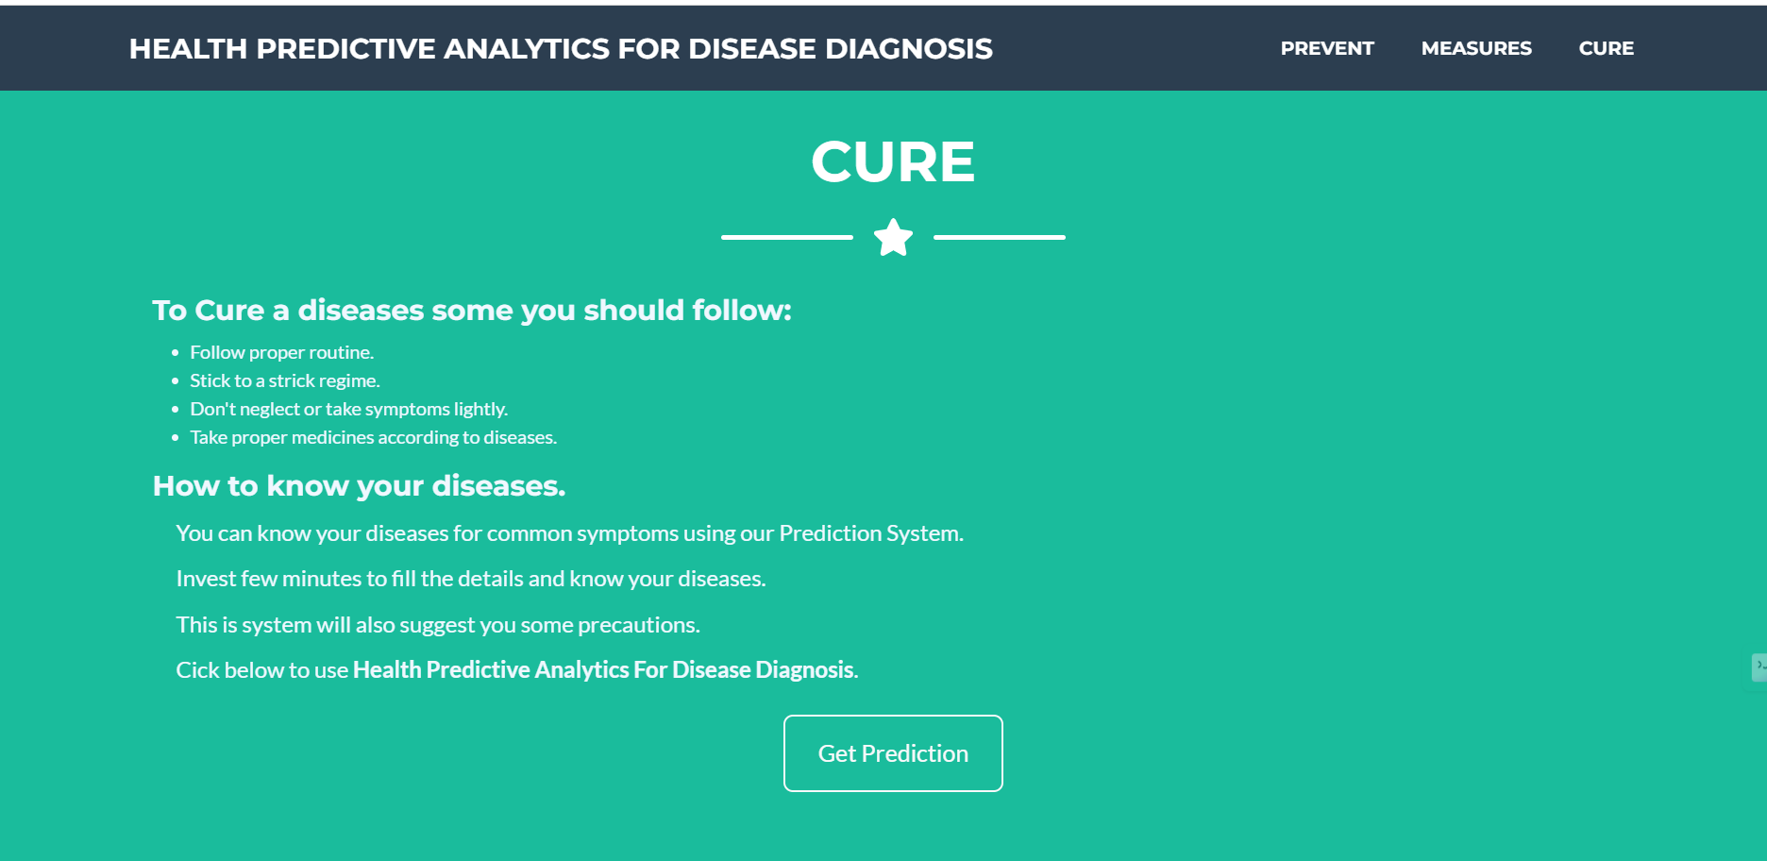
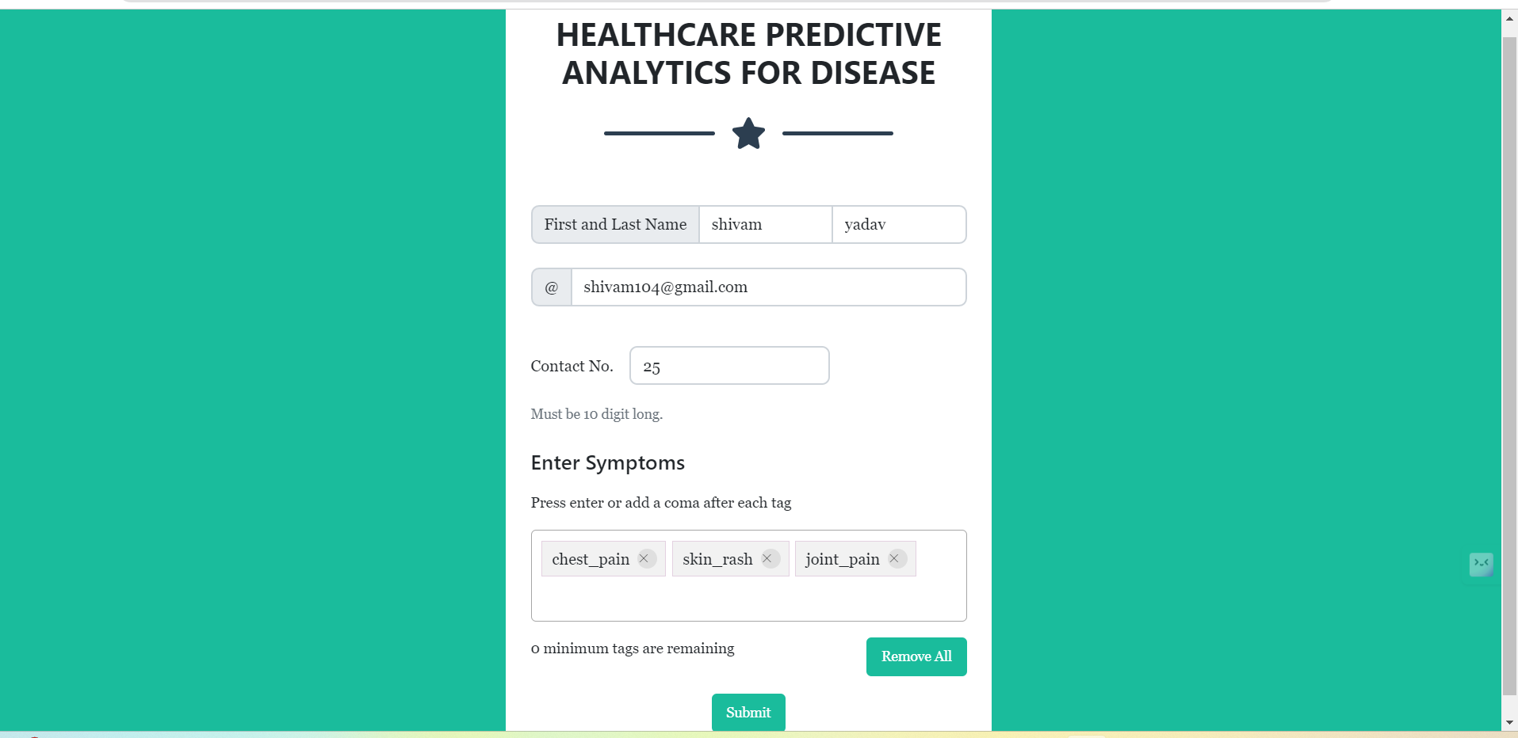

Slide 14
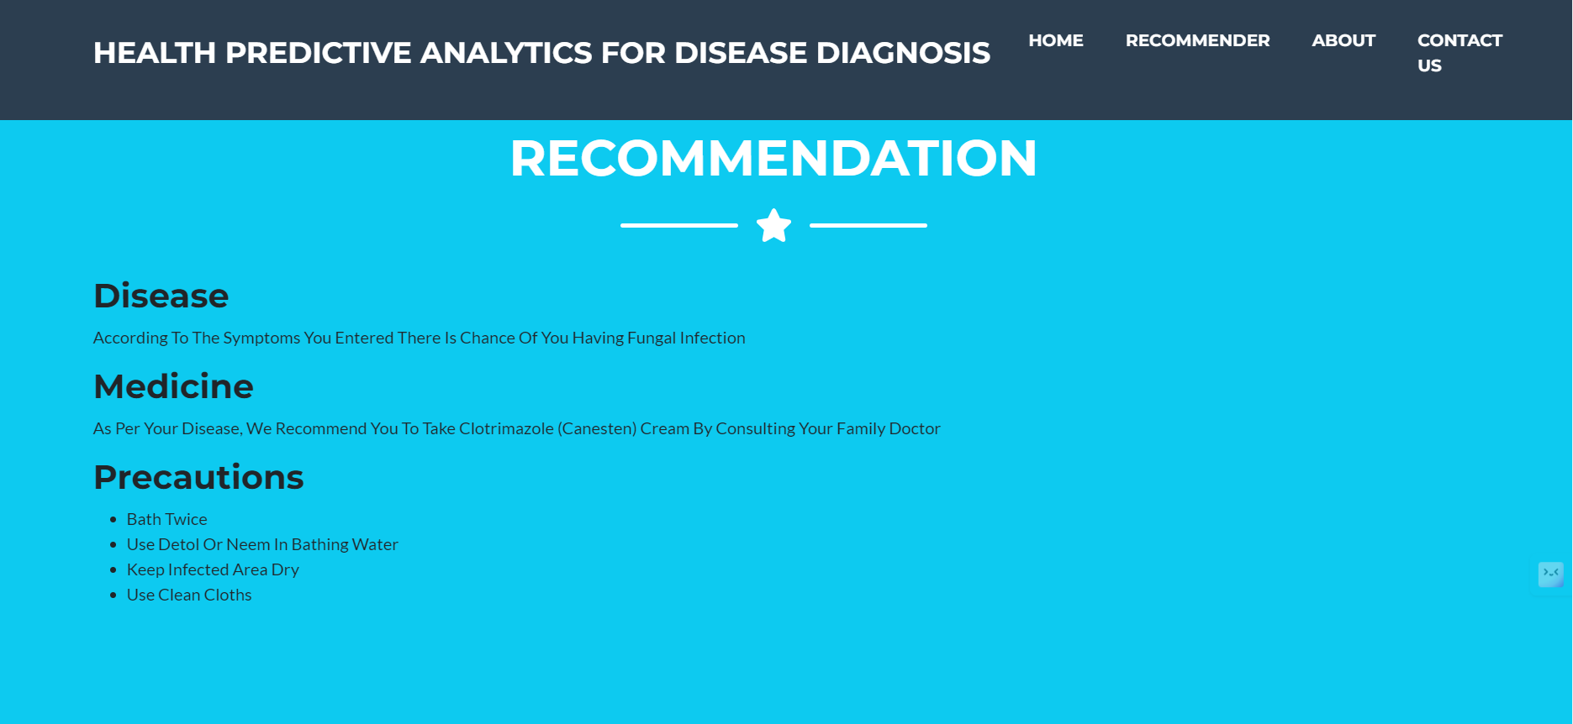
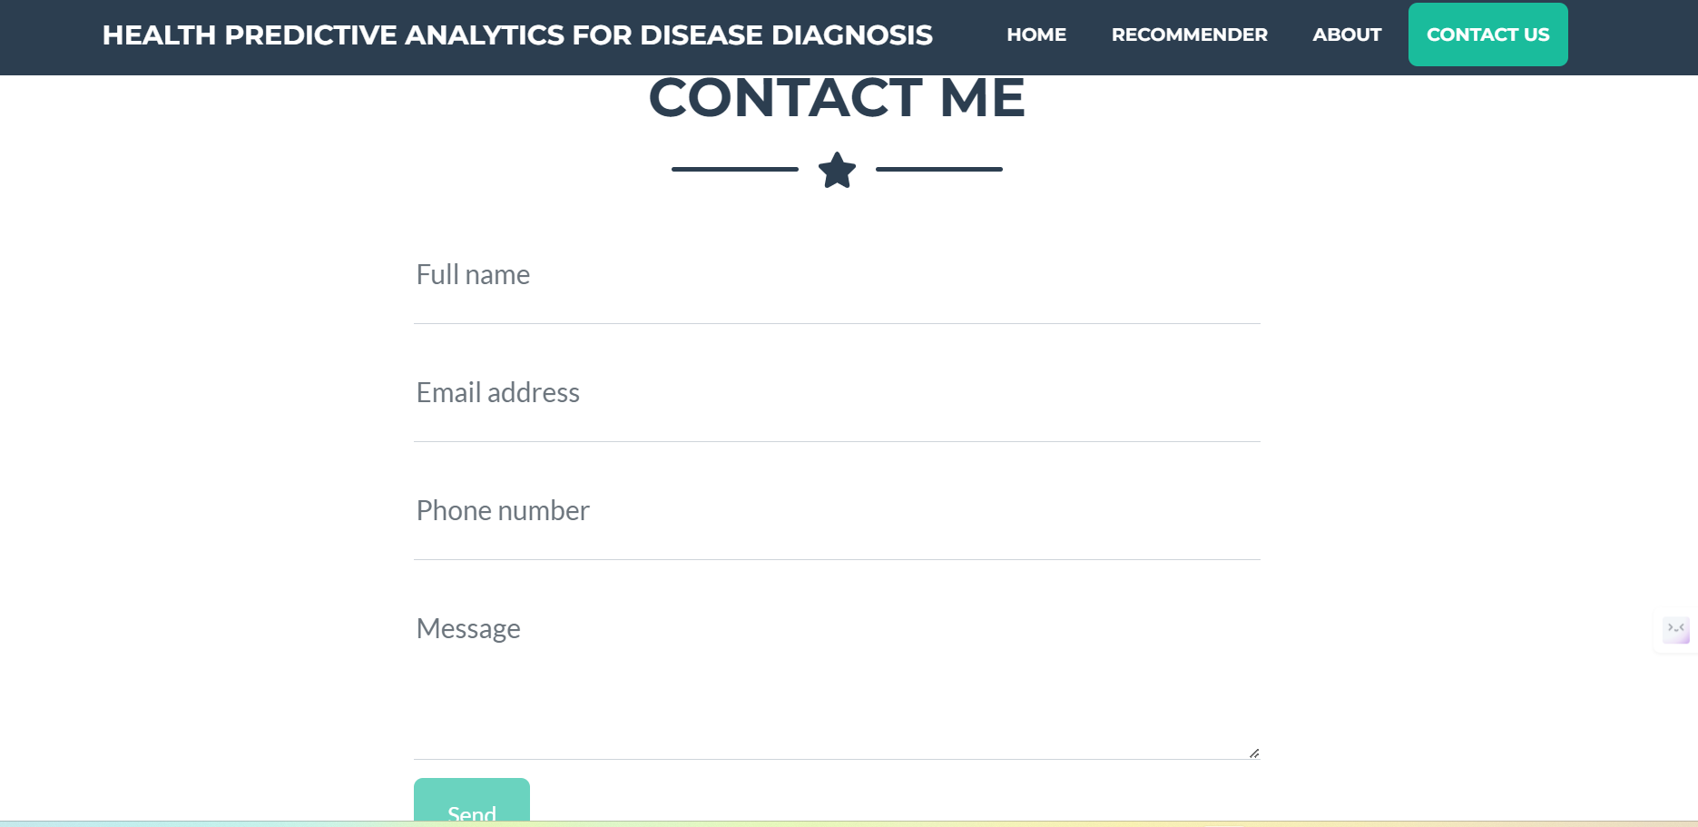

Slide 15
Conclusion
It also confirms that machine learning tools and techniques are decisive in health care province and exclusively used in the diagnosis and predictions of various types of disease.
Machine Learning and predictive analytics techniques could revolutionize the entire healthcare industry by providing accurate insights and predictions related to symptoms, diagnoses, procedures and medications.
There are a lot of open problems and future challenges in dealing with massive amounts of heterogeneous, distributed, diverse, highly dynamic data sets and increasingly large amounts of unstructured and non-standardized information with respect to varied types of disease.

Slide 16
THANK YOU

